Slide 1
Metronus
Time is my capital, not money.
Software Engineering and Professional Practice
Group 1 – 2016/2017

Slide 2
Index
What is Metronus?
Financial information
What have we done?
The team has spoken

Slide 3
Index
What is Metronus?
Financial information
What have we done?
The team has spoken

Slide 4



What is Metronus?
The problem
How much time do my employees spend on each task?
Are they productive?
Are they profitable?

Slide 5

What is Metronus?
Our solution
Time control
Productivity Analytics
Profit Analytics

Slide 6
Index
What is Metronus?
Financial information
What have we done?
The team has spoken

Slide 7

Financial information
Paying our employees
20% extra hours
20% extra salary

Slide 8

Financial information
Marketing
20% of budget on marketing

Slide 9

Financial information
Contingency
20% of budget on contingency

Slide 10
Financial information
Total
Paying our employees: € 22.663,85
Contingency: € 4.537,57
Marketing: € 4.537,57
Total: € 31.738,99

Slide 11
Index
What is Metronus?
Financial information
What have we done?
The team has spoken

Slide 12



What have we done?
Sprint #2
Tune up
Productivity Analytics
Time comsumption analytics
Payment system

Slide 13
What have we done?
Task status

Slide 14
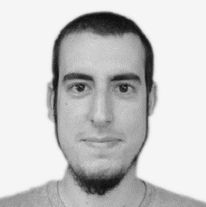
What have we done?
David de los Santos
Project Manager
Estimate (h)
Real (h)
Project management
Monitoring and performance
Sprint#1 enhancement
Presentations
15:00
7:00
1:00
3:00
26:10
6:15
2:30
1:10
3:00
13:15

Slide 15
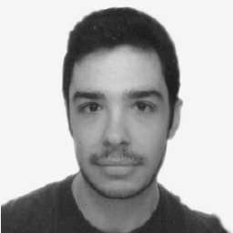
What have we done?
Agustín Borrego
Backend Coordinator
Estimate (h)
Real (h)
Mailing service setup
Monitoring and performance
Refactorization
3:30
3:30
6:00
13:00
1:45
3:15
7:00
12:00

Slide 16
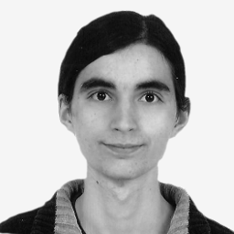
What have we done?
Andrés Doncel
Backend Developer
Estimate (h)
Real (h)
Productivity
Sprint#1 enhancements
3:45
2:25
6:10
5:23
1:00
6:23

Slide 17
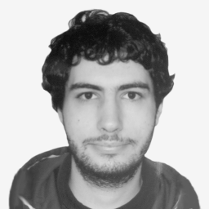
What have we done?
Álvaro González
Backend Developer
Estimate (h)
Real (h)
Project details
Time control interface
User profile
2:00
4:00
1:00
7:00
0:45
7:00
0:15
8:00

Slide 18
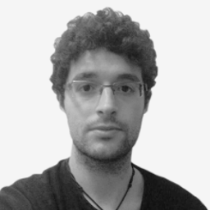
What have we done?
José María Jiménez
Backend Developer
Estimate (h)
Real (h)
Heroku setup
Contact form
Password recovery
Sprint#1 enhancements
2:30
2:00
1:00
1:05
6:35
0:25
2:23
4:21
0:52
8:01

Slide 19
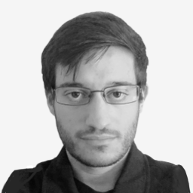
What have we done?
José Antonio Rojo
Backend Developer
Estimate (h)
Real (h)
PayPal research
6:00
6:00
3:51
3:51

Slide 20
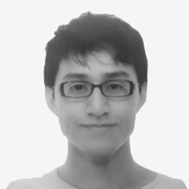
What have we done?
José Renato Ramos
Frontend Coordinator
Estimate (h)
Real (h)
Employees management
Tasks management
5:30
3:00
8:30
4:39
2:48
7:27

Slide 21
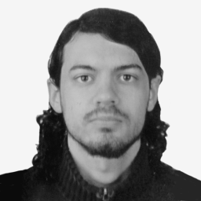
What have we done?
José Gavilán
Frontend Developer
Estimate (h)
Real (h)
Roles management
Departments management
1:50
5:00
6:50
3:05
2:25
5:30

Slide 22
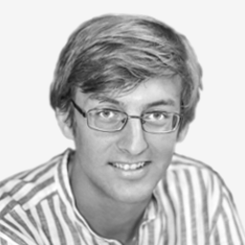
What have we done?
Andrés Jiménez
Frontend Developer
Estimate (h)
Real (h)
Time control
Projects management
4:20
6:00
10:20
7:10
5:00
12:10

Slide 23
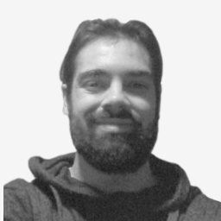
What have we done?
Juan Carlos Liébana
Frontend Developer
Estimate (h)
Real (h)
Contact Form
Sprint#1 enhancements
1:00
1:40
2:40
1:10
1:45
2:55

Slide 24
What have we done?

Slide 25
What have we done?

Slide 26
What have we done?

Slide 27
What have we done?
Let’s stop a moment think about performance and standards

Slide 28
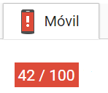
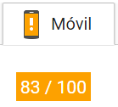
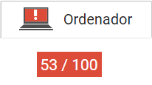
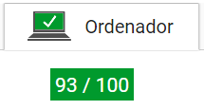
What have we done?
Google InSights
Before
After

Slide 29
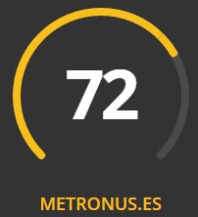
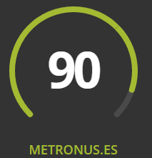
What have we done?
Grader
Before
After

Slide 30
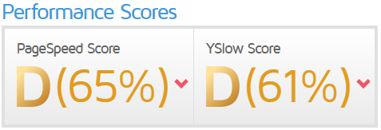
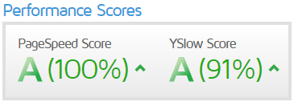
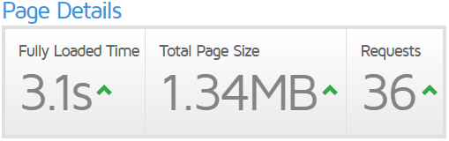
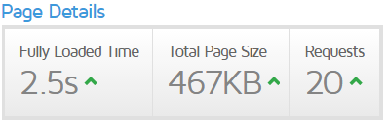
What have we done?
GTMetrix
Before
After

Slide 31
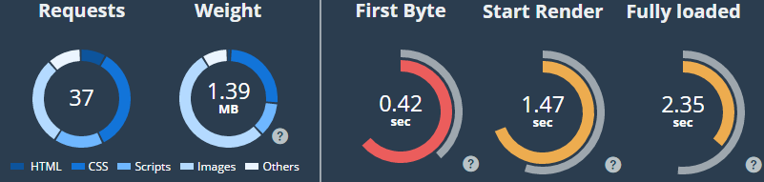
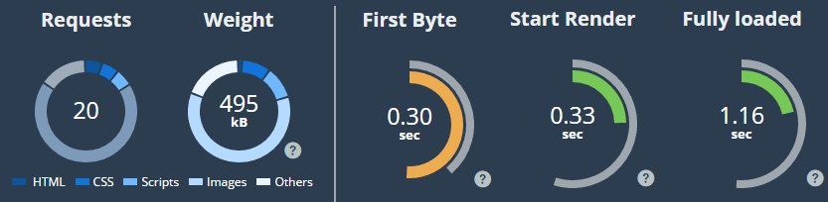
What have we done?
Dareboost
Before
After

Slide 32
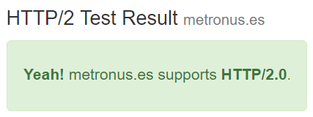
What have we done?
KeyCDN Test for HTTP/2.0

Slide 33
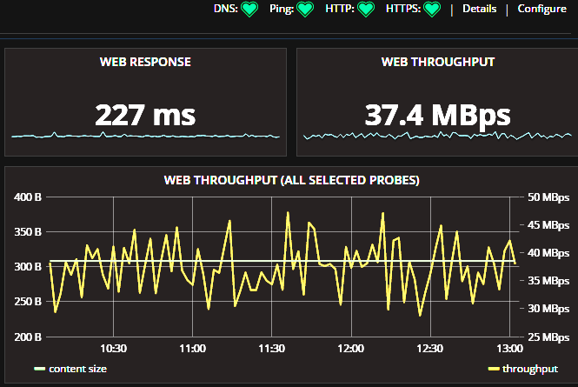
What have we done?
Grafana on stats.metronus.es

Slide 34
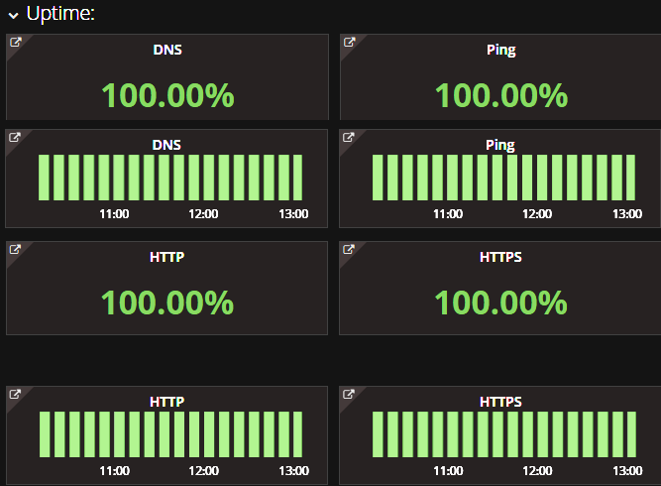
What have we done?
Grafana on stats.metronus.es

Slide 35
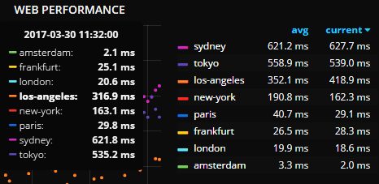
What have we done?
Grafana on stats.metronus.es

Slide 36
Index
What is Metronus?
Finantial information
What have we done?
The team has spoken

Slide 37


The team has spoken
What do they think?
Satisfaction
7,3
Motivation
6,4

Slide 38
The team has spoken
What do they think?
More proactivity
More documentation
Teammate support
Teammate rotation

Slide 39


The team has spoken
What do they think?
Planning
6,1
Assigned tasks
6,9

Slide 40
The team has spoken
What do they think?
More detailed tasks
More uniform tasks
Stricter deadlines
Better frontend-backend division

Slide 41


The team has spoken
What do they think?
Commitment
7
Code quality
6,8

Slide 42
The team has spoken
Solutions
Metronus as portfolio
More testing
Documentation
Coding standards

Slide 43



Metronus
Time matters.
Thank you!
info@metronus.es
www.metronus.es
stats.metronus.es

